Slide 1
Chips Category Analysis – Final Report
Sahid Anwar
July 2025

Slide 2
Executive Summary
• Chips category analysis shows strong performance in certain customer segments.
• Trial store campaign led to a significant uplift in sales.
• Recommendations provided for targeting high-value segments and expanding campaign.

Slide 3
Task 1 – Customer Segment Insights
• "OLDER FAMILIES – BUDGET”showed highest chip sales.
• Budget customers bought high but are more in number.
• Promotions should target high-value segments.

Slide 4
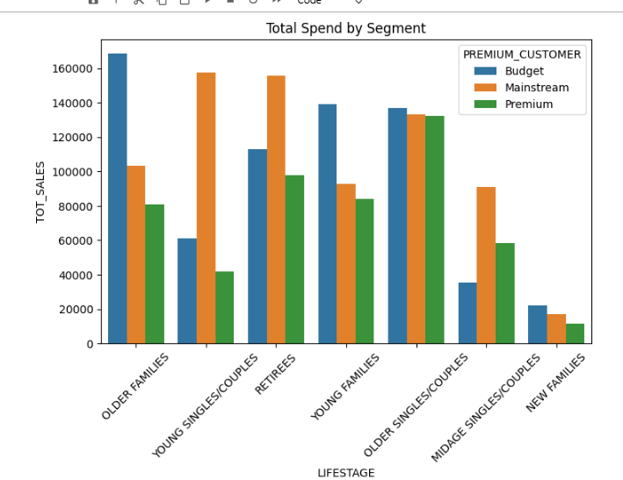
Total Sale by segment

Slide 5
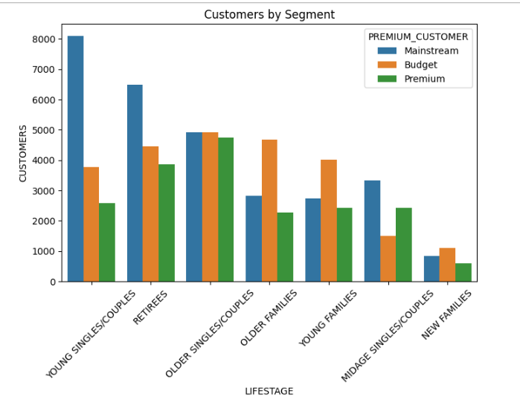
Total customer by segment

Slide 6
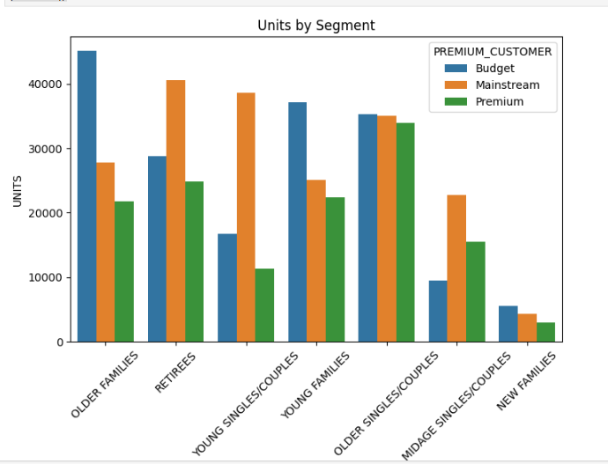
Total Quantity by segment

Slide 7
Task 2 – Trial Store Performance
• Trial store showed uplift of 10–15% compared to control stores.
• Seasonality and trend-adjusted evaluation indicates campaign success.
• Recommending scale-up to similar stores.

Slide 8
Recommendations & Next Steps
• Continue targeting ‘Mainstream’ and ‘Premium’ segments.
• Replicate successful trial campaign in similar demographic stores.
• Monitor uplift continuously and adjust promotions.

